Slide 1
Spacecraft, Spies, and Cyphers: How cryptography isn’t just for spies anymore
JP Burke and C. Schiff

Slide 2
About Your Humble Presenters
JP Burke
Works at Goddard Space Flight Center (GSFC) as a software developer on the ‘A-Train’, a constellation of Earth-observing spacecraft (Aqua, Aura, Cloudsat, Calipso)
Young, intelligent, works social media brilliantly, and spends a bit too much on his podcast (The Space Above Us)
Hopelessly devoted to subtitled anime
Conrad Schiff
Works also GSFC, currently as a plasma physicist on the Magnetospheric MultiScale (MMS) mission
Old, addled, but still productive (www.blogwyrm.com) and now officially a curmudgeon
Cleverly knows when to watch dubbed anime
Disclaimer: Our opinions are our own and not the official policy of the US Federal government, NASA, or a.i. solutions, Inc.

Slide 3

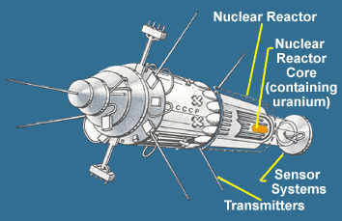
Secret Messages and Space – An Average Impression
Ask just about anyone what images come to mind with the two words ‘Secret Messages’ and ‘Space’ you’ll likely get something like:
Kosmos 854, the Soviet spy satellite that rained radioactive debris over northern Canada in 1978
Death from above scenarios like this scene from the movie Real Genius

Slide 4
Real Spy Satellites
Hexagon
WFIRST

Slide 5
But Secret Messages Aren’t Just for Spies
Of course modern world is filled with the need for both encoded messages and encrypted messages
Encoded messages – idea and concepts put into a format that can be shared between people
Spoken and written language
Mathematics, science, and engineering
Music, poetry, painting, etc.
Monetary and financial transactions
Computer communications
Encrypted messages – ideas and concepts put into a format that is intentionally aimed at securing a communication from the sender (Alice) to the recipient (Bob), excluding everyone else (Eve)
Spies, national security, state department communiques
SSH, secure online purchases
Sensitive data (SSN, medical history, etc.)
Spacecraft commands and communication

Slide 6

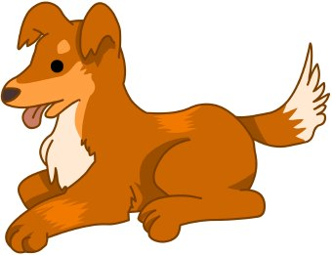
Encoding – Who Needs It?
What water?
Encoded messages are the central part of our communications – so much so that we don’t notice the encoding
All language is like that whether it is human (spoken, written, drawn, etc.), animal, computer, advertising, and so on
Encoded messages can seem like encrypted ones until you ‘learn’ how to decode – consider this scene from Haibane Renmai

Slide 7


Slide 8
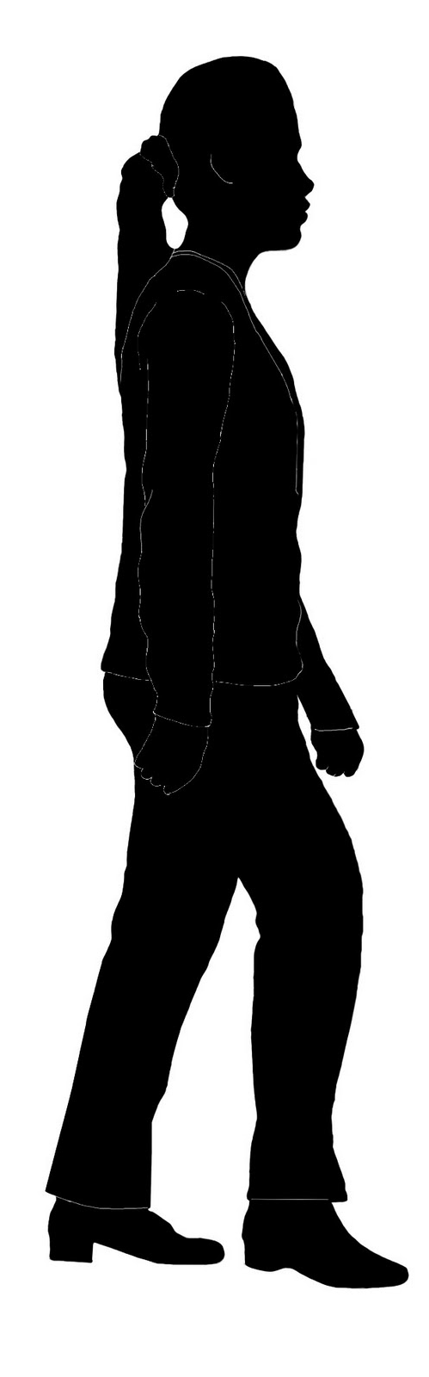


Alice, Bob and Eve
Alice
Bob
Eve

Slide 9
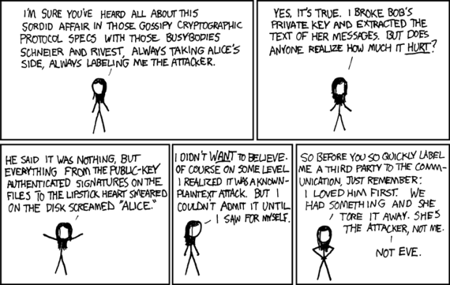
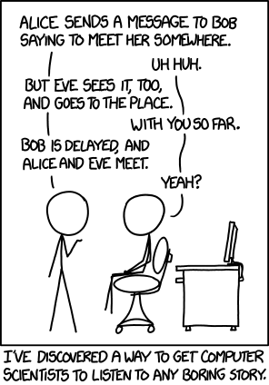
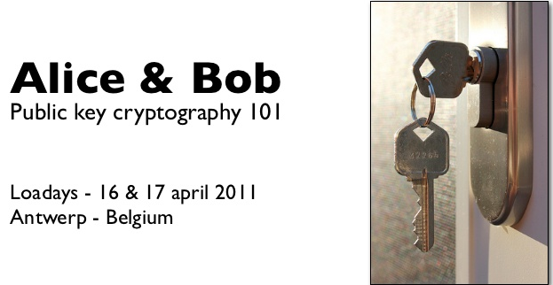
There is a whole culture devoted to Alice, Bob, and Eve
The trials, travails, and other sordid details of Alice’s, Bob’s, and Eve’s ‘soap opera’ have captured the attention of even the most stuffy of mathematicians, physicist, and computer scientists
Source:
https://vicky2183.wordpress.com/2010/06/08/interesting-characters-in-cryptography/
http://www.bookrags.com/wiki/Alice_and_Bob
Xkcd.com

Slide 10
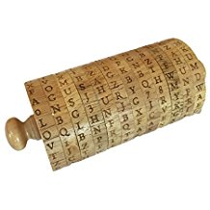
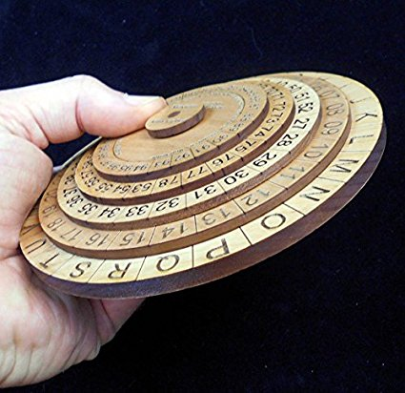

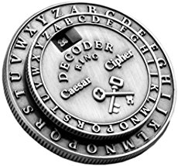
Encryption Devices – Pre Computer

Slide 11
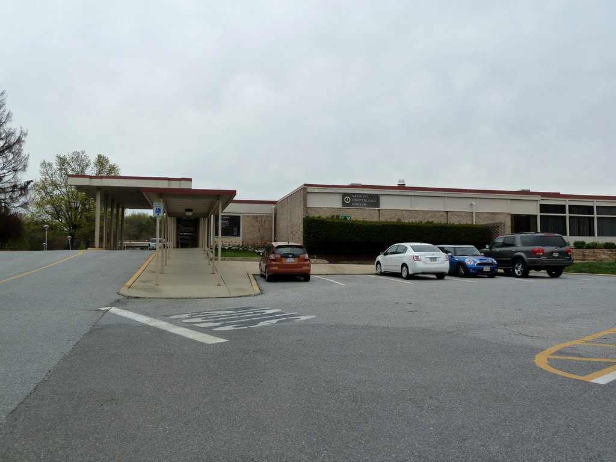
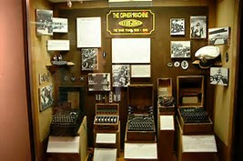
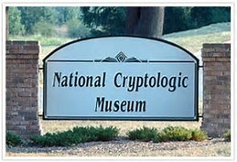
Cryptological Museum
Run by the NSA

Slide 12
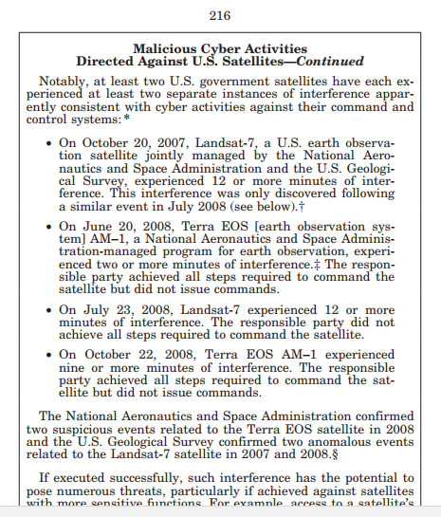
Secret Messages and Encryption
Pin to lock your cell phone – why?
What happens when you don’t
Radical Edward

Slide 13
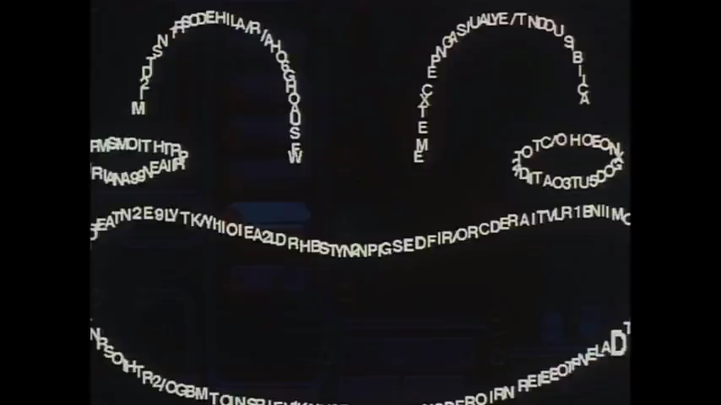

Slide 14
Top Secret

Slide 15


Slide 16
